Slide 1
Smart Content
Delivery And
Absorption
Summary : A smart way to Detect and Quantify the Teaching Learning Experience in rural schools using Deep Learning, Speech and Text Processing, giving a one stop solution to education boards in ensuring uniformity and improving quality of imparted education.
Team Synchrony : Shriya Nagrath ( Oracle )
Varad Bhatnagar ( IIT Bombay )

Slide 2
TABLE OF CONTENTS
01
02
03
04
05
Introduction
Problem Statement
Problem Factor
Approach
Overview of Solution

Slide 3
INTRODUCTION
India has been able to provide quality education in its cities and towns effectively, by employing quality teachers, technological aids and policy decisions but we have not been able to replicate the same at the rural level where 66 % of our population lives.
The lack of quality education at rural level is hurting the country in many unimaginable ways. Substandard teachers, lack of student participation and lack of discipline is affecting the quality of education being imparted.
It gives rise to uneducated and unemployed youth leading to a spike in poverty, drug abuse, lawlessness and crime. Such a scenario is killing our economy and presenting a negative image of the country to foreign eyes.

Slide 4
-Benjamin Franklin
“If a man empties his purse into his head, no man can take it away from him. An investment in knowledge always pays the best interest.”

Slide 5
PROBLEM STATEMENT
Substandard teaching and lack of interest on the part of students leads to a poor learning experience in Rural Schools. The quality enforcement mechanisms i.e. audits and inspections are also inconclusive because of corruption. Due to these issues, the rural education scenario is dismal and there is a dire need of uplifting the standards.
A technology aided solution is needed which can quantify the teaching-learning experience in a course subject in a rural setting.

Slide 6
PROBLEM FACTORS
Substandard Teachers
Lack of Interest On Part of Students
Poor Enforcement Mechanism
The popular sentiment in rural areas is that education is useless. It is so because most of their uneducated youth remain unemployed .
Thus, the students care less about learning and more about passing.
Most schools in rural areas are affiliated to state boards. There is lack of uniformity in standards across the 20+ boards in the country.
Also, due to rampant corruption and lack of accessibility, enforcement of rules is hard.
It is difficult to find quality teachers in Rural Areas. Most teachers themselves products of this broken rural education system.

Slide 7
APPROACH
We aim to compute CADS score which will quantify the teaching learning experience in a class. This score will be computed using a variety of Deep Learning techniques such as Optical Character Recognition, Speech Analysis and Natural Language Processing.
Data Driven decisions such as replacement of faculty / shuffling of classes can be taken based on this score.
The various techniques and their intricacies have been explained in the following slides.

Slide 8
OVERVIEW OF SOLUTION
The solution will be explained in the following manner:
Brief explanation of all techniques
Pictorial Representation of Modules
System Setup Diagram
Technical Requirements
Development Plan

Slide 9
SPEECH ANALYSIS
Problem : In rural areas, teachers are not very interested in teaching. Some of them are qualified on paper but lack knowledge and communication skills. This leads to intentional or unintentional wastage of class hours which leads to a poor teaching-learning environment.
Solution : The content which is scheduled to be covered in a particular class will be uploaded in pdf format to our application. A Speech to Text Model will analyse the speech of the teacher in real time and convert it into text.
We will perform Name Entity Recognition on both these texts and compute a number on the scale of 0-100 which will give the Percentage of Keywords Spoken covered in the lecture against the contents of the chapter.
Impact : The Percentage of Keywords Spoken (PKS) in a class will give us a good estimate of the quality of teaching. It will also encourage teachers to prepare well before coming to class and utilise the class hours effectively.

Slide 10
2. BOARD ANALYSIS
Problem : Some topics need extensive work on the blackboard, to be understood properly by the students. Labelled Diagrams in Biology and definitions in Physics and Chemistry are some things which are explained better on the board. Some teachers hesitate to take these efforts due to lack of knowledge or lethargy
Solution : Technique #1 would be used to capture the voice of the teacher. Whereas ,this technique will capture the text written on the black board by the teacher.
The content which is scheduled to be covered in a particular class will be uploaded in pdf format to our application. An Optical Character Recognition model will convert the images of the board into text. We will perform Name Entity Recognition on both these texts and compute a number on the scale of 0-100 which will give the Percentage of Keywords Written covered on the board against the contents of the chapter.
Impact : The Percentage of Keywords Written (PKW) in a class will give us a good estimate of the quality of teaching. It will encourage the teacher to write important definitions / dates, illustrative diagrams and facts and figures on the blackboard for students to note down.Also,using the blackboard while teaching has been proven to be one of the most effective ways of making things lucid to pupils and enabling them to remember concepts easily.

Slide 11
3. MOOD DETECTION
Problem : At times students are distracted,or just plain naughty and don’t concentrate in the class. In such a scenario, a sincere effort to teach is not met with much success. It becomes important to understand such nuances, if we are to succeed in improving the overall rural education scenario. (PS : We are not against a bit of fun in class,afterall we all remember doing that at school fondly,but there ought to be learning as well)
Solution : We will detect the mood of the students using a Mood Detection from Facial Expressions Model. Using a camera aimed at the class, we will be able to detect the mood of the class and also count the number of people attending the class.
Basic moods can easily be detected and this technique will give us an idea if the students are sleepy or attentive or happy or sad. This technique will also give us a number on the scale of 0 - 100 representing the Mood (M) of the class, 100 being most favorable.
Impact : The subject co-ordinator / principal can then make subtle changes in curriculum to improve the response of the class.

Slide 12
CADS SCORE
Using the 3 measures listed in the previous slides, namely :
Percentage of Keywords Spoken (PKS)
Percentage of Keywords Written (PKW)
Mood (M)
Based on this, we will compute a measure Content Absorption and Delivery Score (CADS) which will be a representative of the overall Teaching Learning Experience of a subject in a school. This score will be on a scale 0 - 100, where 0 represents a poor experience and 100 represents the ideal experience.
CADS Score = 0.8 * (PKS+PKW) + 0.2 *M
This score will be available to the coordinator / principal of the school as a measure of the quality of education being imparted at the school.
This score will be extensible and open to changes, if new techniques of measuring education quality are added in the future.

Slide 13
MODULES
UI MODULE
ASR MODULE
MOOD DETECTION MODULE
OCR MODULE
This module will provide a rich UI interface for a teacher/ supervisor. It will compute a score for the teaching learning experience using inputs from the other three modules.
This module will convert speech (of lecturer) to text and match it against the contents of the chapter.
It will use a Speech to Text Model and perform NLP tasks such as Name Entity Recognition and Part of Speech Tagging.
This module will detect the mood of the students using facial expressions during the class hours using an emotion detection model and a camera.This analysis would give a fair idea of whether the topics being taught are lucid to the children or not.
This module will perform Optical Character Recognition on the content of the Black Board and match it with the contents of the chapter.

Slide 14
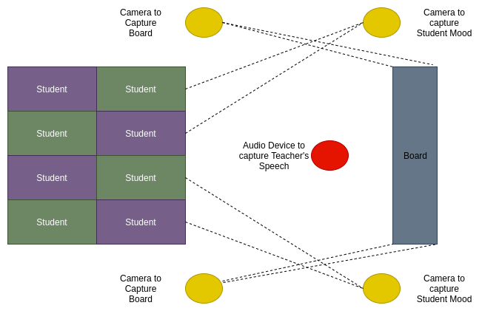
SYSTEM SETUP DIAGRAM

Slide 15
TECHNICAL REQUIREMENTS
Framework : Django
Language : Python, HTML, CSS, JavaScript
Libraries : NLTK, Spacy, OpenCV
Tools : Kaldi ASR
Datasets : Hindi Wordnet(We are focusing on Hindi presently and extend to other regional languages eventually)
Webcam

Slide 16
DEVELOPMENT PLAN
01
02
03
04
Build Speech to Text Module
Build Optical Char. Recog. Module
Build Mood Detection Module
Integrate all modules and UI

Slide 17
CONCLUSION
We have identified that apart from other factors like poverty, lack of quality teachers, needs of the family hindering students from attending school ,the major factor hindering quality education imparted at the rural schools is the absence of “will”.
Well, we can’t induce will in the students overnight using technology. But, what we intend to do is keep a check on the efforts being put by teachers in a class and the interest of the students in the classes so that appropriate measures can be taken to improve the current scenario.
Like there is no point building an extravagant building on top of a withering base, there is no point working on elaborate content or examination and assessment strategies till the time we don’t check whether the pupils are even imbibing something or not.
That is exactly what we intend to do!!!

Slide 18
THANKS!
Do you have any questions?
Email :
varadhbhatnagar@cse.iitb.ac.in
shriyanagrathpm1997@gmail.com

